Slide 1
Africa GeoPortal
Geospatial Tools and Content for Africa
Pauline Okeyo
Esri

Slide 2
The Africa GeoPortal
“
We are deeply committed to supporting innovation in Africa, helping users discover, explore, and understand the vast information available to them through the power of maps
”
Jack Dangermond
President and Founder of Esri

Slide 3
The Africa GeoPortal: Vision & Objectives
The vision is to provide a ‘one stop shop’ portal for geographic content and comprehensive web GIS tools, free for single users residing, supporting efforts, or working in Africa
This will:
Remove the barriers to entry to geospatial technology, data and learning for users working in or on Africa
Enable a sustainable portal of portals for existing and new geospatial data focused on Africa
Provide a platform to promote premium data, solutions and value add services to Esri users across Africa

Slide 4
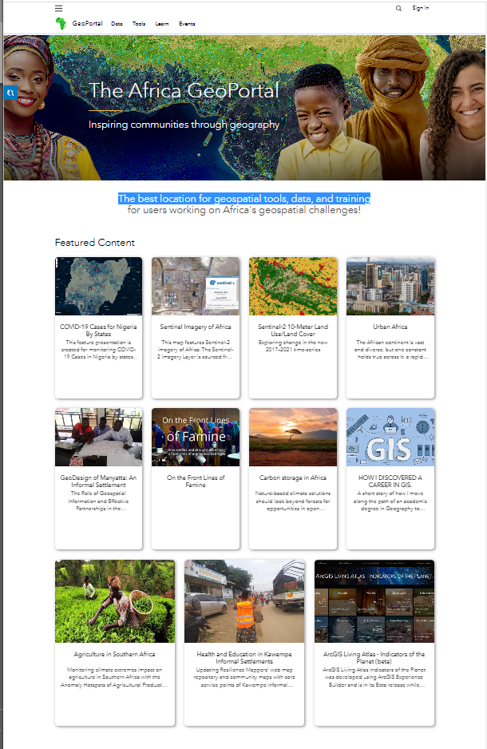
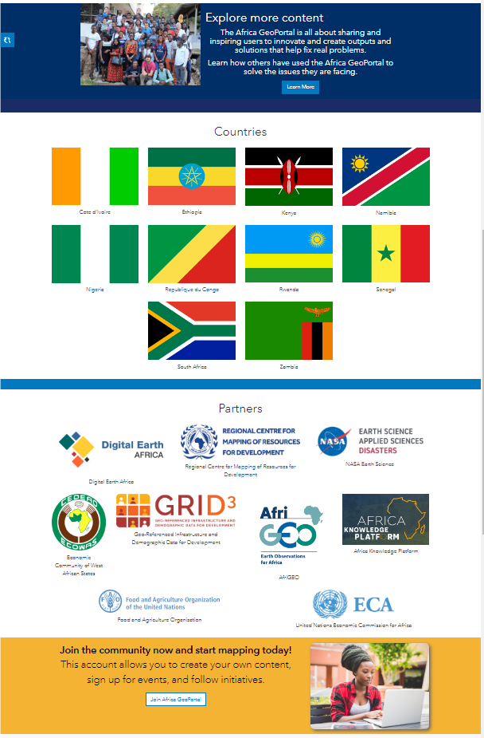
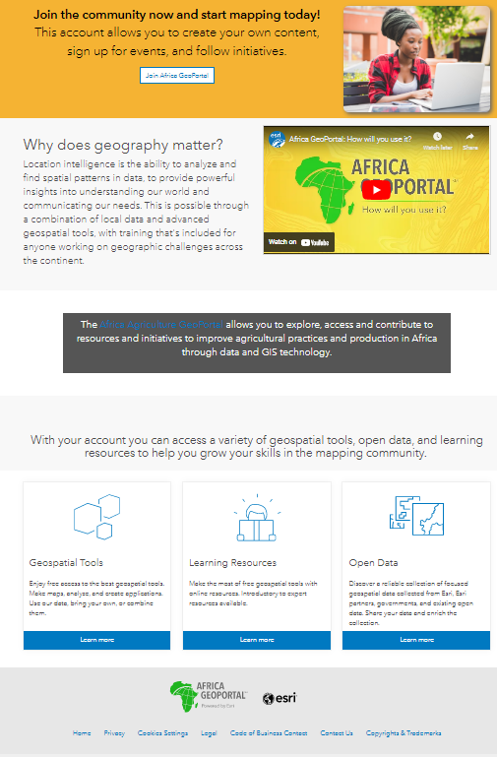
The Africa GeoPortal

Slide 5
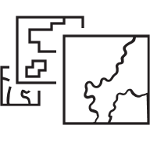
The Africa GeoPortal: Capabilities
Access Geospatial Tools
Free access to the best geospatial tools to make maps, do analysis and create applications
Learning Resources
Online training resources to guide users to make the most of the geospatial tools
Africa Living Atlas
Authoritative collection of African geospatial data
User Success Stories
Stories shared by Africa GeoPortal users intended to encourage and inspire others
Notes:
One slide for each items (animation hilghliting box)
Learning” Short videos 3mins (examples from esri training site)
Success stories (example story maps from Africa)
Living Atlas (sample of LA for afria data)
Marketplace (encouraging to app to be developed by African young developers and startup to show their geospatial )
News nd blogs esri grant for land admin and statistics for the developing countries)

Slide 6
Tools on Africa GeoPortal
Integrating and Leveraging Many Innovations
IoT
Real-Time
Voxels
Analytics
Infographics
Big Data
Meshes
Charts
Interactive Mapping
3D Visualization & Analytics
Clustering
Data
Sciences
Webhooks
3D Objects
Automation
Image
Processing
Game
Engines
Advanced Spatial Analytics
Decision Support
Enterprise
Integration
Hub
5G
Notebooks
Computer Vision
BIM
Micro
Services
GeoAI & Machine Learning
Shared Services
Network Performance
Prediction
Kubernetes
Builders
Open Data
StoryMaps
Forecasting
Cloud Computing
Reality
Capture
Imagery & Remote Sensing
APIs
Embedded
Apps
Lidar
Scalable
Dashboards
Field
Web Maps

Slide 7
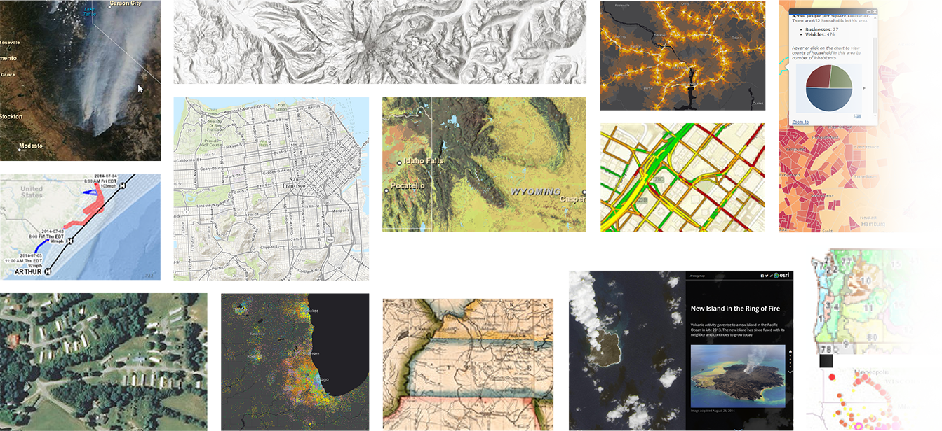
Africa GeoPortal includes ready-to-use content
Basemaps, maps, apps, layers, and more from Esri and the global GIS community – a Living Atlas
Transportation
Environment
Habitats
Places
Observations
Trending
Landscape
POI
Elevation
Infrastructure
Basemaps
Business
Traffic
Boundaries
Soils
Movement
Land Cover
Hydro
Hazards
Imagery
Oceans
Weather
Historical
People
AI6 Layers
Demographics
… curated, authoritative content with continuous updates
Notes:
Africa GeoPortal includes a collection of curated, ready-to-use content in the form of basemaps, layers, maps, tools, apps and more. That collection is the Africa Living Atlas.
All of it is curated, authoritative, and continually updated.
Content portfolio – basemaps, imagery, boundaries, environment, infrastructure, people
Includes Esri content, partner content and community of users > state, and county governments, cities, environmental groups, universities, private companies, and more. Anyone can contribute and we encourage you to do so.

Slide 8
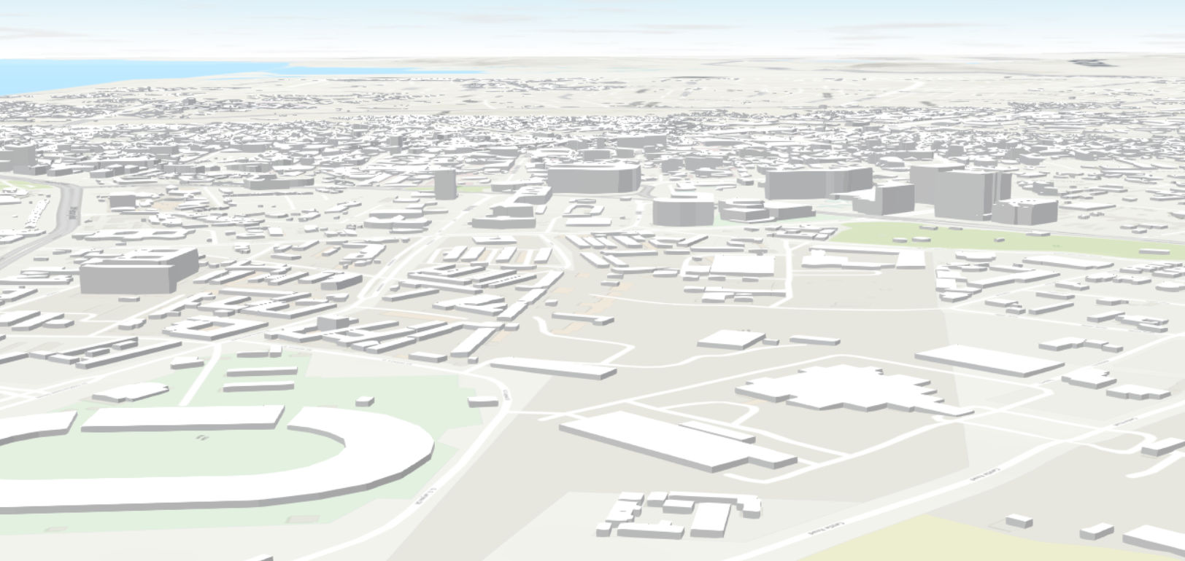
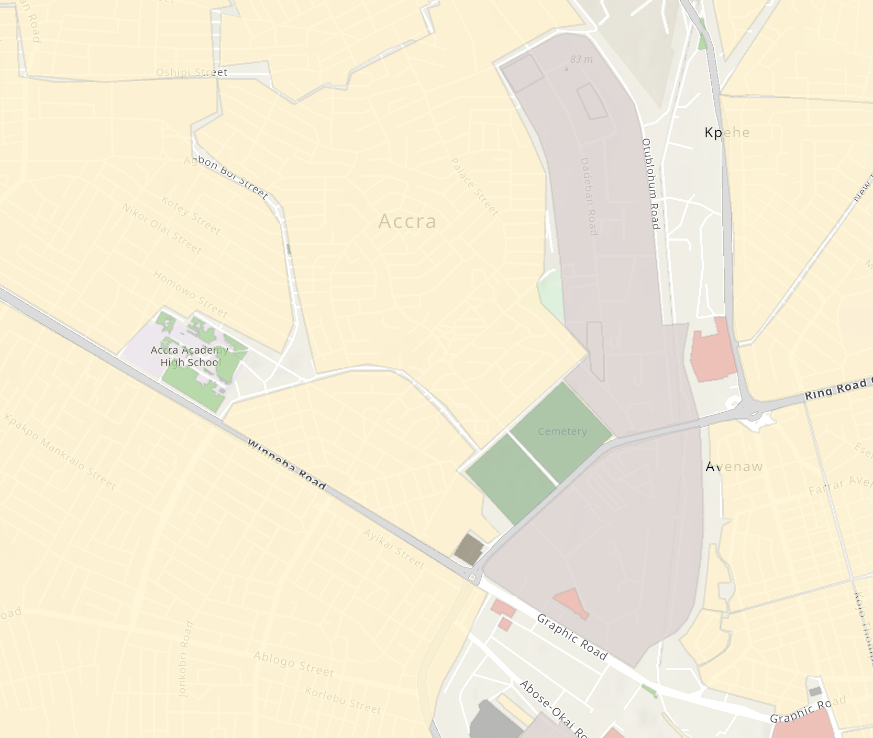
Crowdsourced data
Amenities
Esri hosted feature layers of live OpenStreetMap data
Africa GeoPortal providing OSM data for Visualization, Analysis, and Extract
Layers include Buildings, POIs, Streets, etc.
Layers are updated with minutely diffs from OSM to present the latest updates!
Layers can be easily re-styled, with custom popups
Buildings
Landuse
Notes:
In addition to our vector basemap, this year we are introducing new OpenStreetMap Feature Layers to support more use cases.
Esri will provide OSM data as hosted feature layers in ArcGIS Online to support Visualization, Analysis, and Extract capabilities. This will include layers such as …

Slide 9
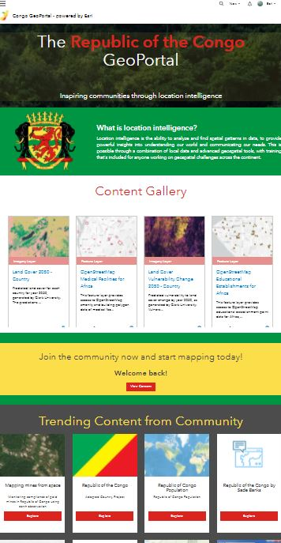
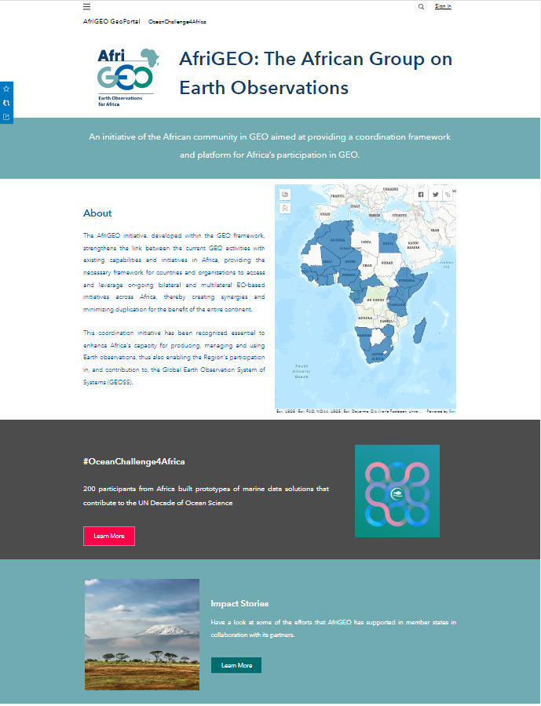
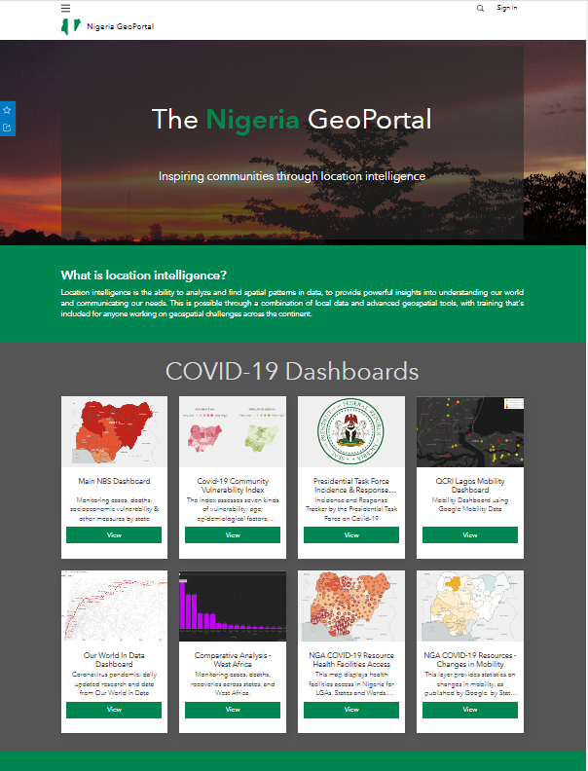
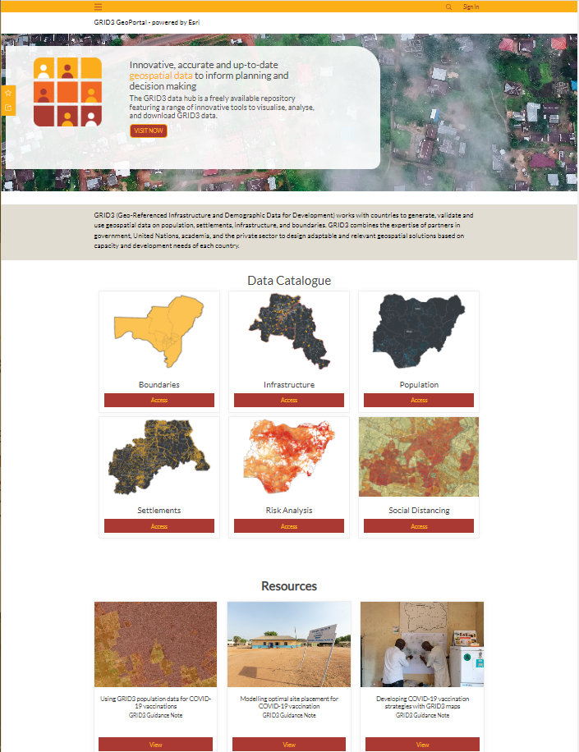
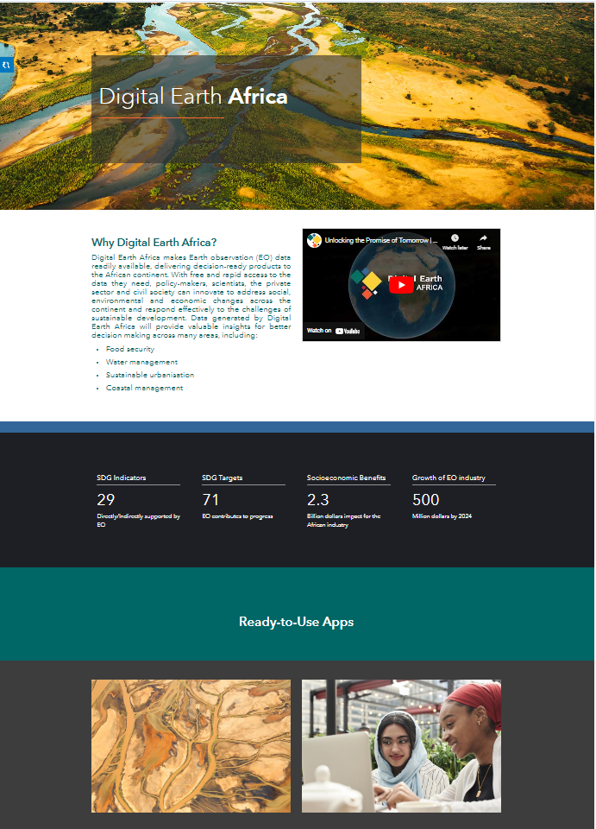
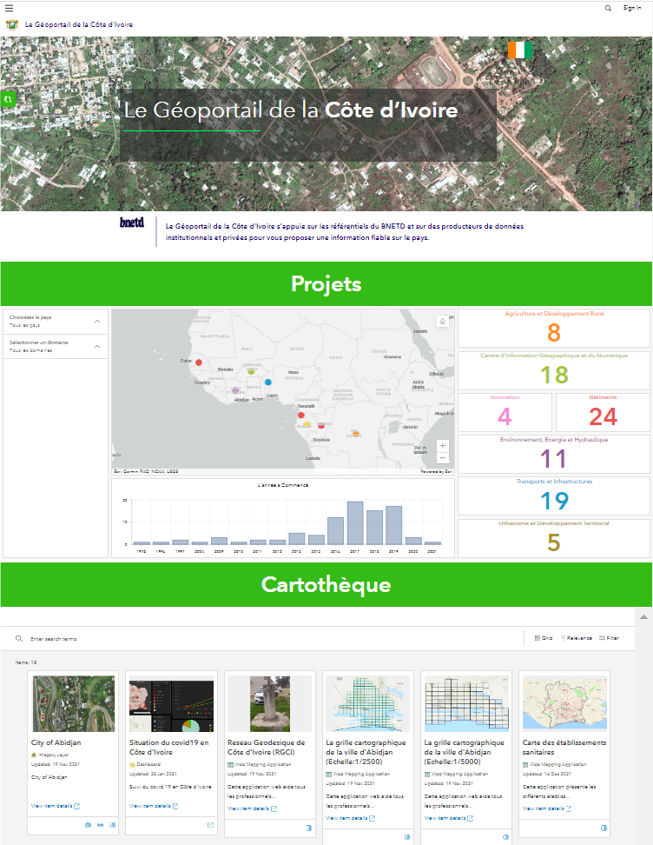
Sites on Africa GeoPortal
Notes:
To share easy to search catalogs of data that cross agencies, making it easy for the public and staff to find what they are looking for.

Slide 10
The Africa GeoPortal: Pages and sites
Africa GeoPortal
Rwanda GeoPortal
Senegal GeoPortal
Digital Earth GeoPortal
Countries or key partners can create focussed pages under The Africa GeoPortal to promote
Specific data,
Stories,
User communities
Benefits include
Free template for easy adoption
Ongoing core platform supported by Esri
All content from Africa GeoPortal
NIGERIA GEOPORTAL
KENYA GEOPORTAL
UNECA GEOPORTAL
SOUTH AFRICA GEOPORTAL
AFRIGEO GEOPORTAL
Notes:
Country and partner pages help extend and localize Africa GeoPortal
Run by the partner or local country team in the same platform
Country or partner need to commit with initial data, local content and ongoing content input
Content Library accessed through search results, category searches and galleries
Add content from other locations
Convey Information
Share Data & Content
Collect Data & Feedback from the Community
Organize Collaboration

Slide 11
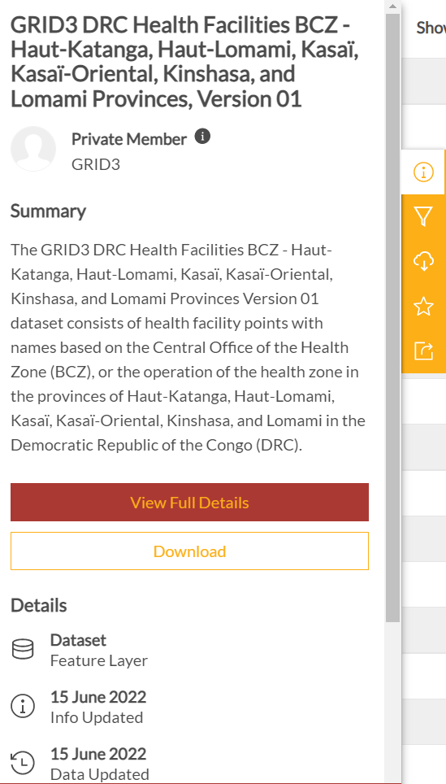
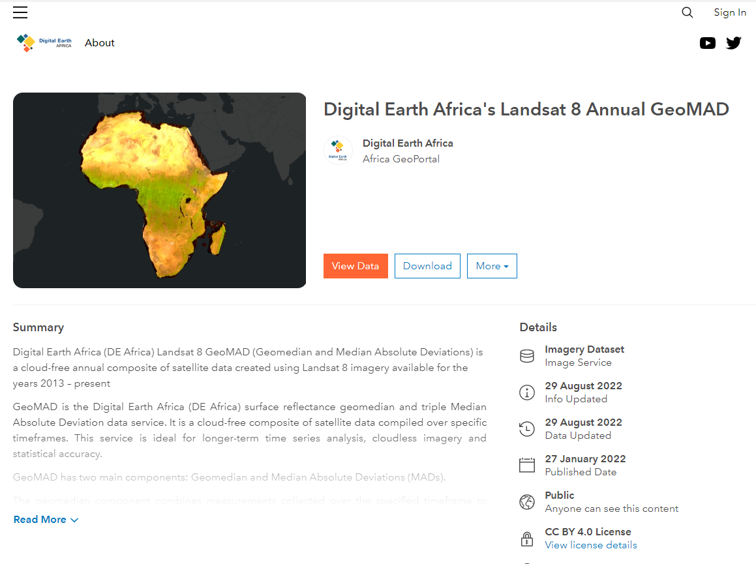
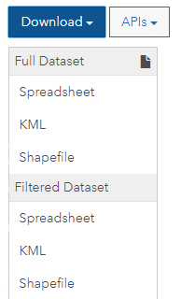
Data Set Views, Downloads, and APIs

Slide 12
Africa GeoPortal Identities
Agency
Individual
Community

Slide 13
Africa GeoPortal Identities
Agencies
Open Data
Teams
Sites & Pages
Dashboards
Followers
Feedback

Slide 14
Africa GeoPortal Identities
Individuals

Slide 15
Africa GeoPortal Identities
Individuals
Community Identities
Events

Slide 16
The Africa GeoPortal: Sustainable
What is Esri committing to:
Keep the platform running as long as it is needed and used
Support project data to it continues to be accessible
Be a portal of portals, referencing or hosting geospatial data regardless of source
Promote the Africa GeoPortal and gain contributions from other Esri initiatives (Land, Statistics, Health Grants)
Ongoing support commitment from Esri

Slide 17
How will you use it?
africageoportal.com

Slide 18
Acknowledgement

Slide 19
Thank you
Questions?

